Slide 1

Indian pharmaceutical market analysis
2014 To 2019

Slide 2
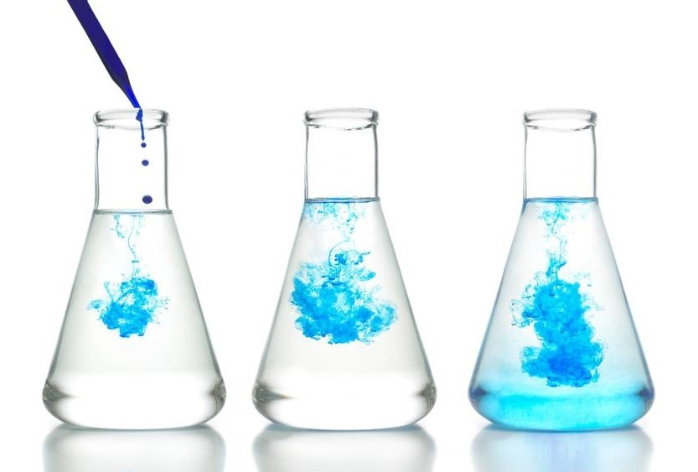
Problem statement
Pharmaceutical Companies In India Face Challenges In Identifying Which Drug Categories And Compositions Are Most Profitable And Consistently In Demand.
The Market Is Flooded With Thousands Of Brands And Generics, Making It Hard To Spot High-opportunity Areas For Portfolio Optimization, Pricing Strategy, Market Targeting and Form OF Drug.

Slide 3

N05B(Anxiolytics) & N02BE (Paracetamol) key segment for mental health, and pain relief.
Diagnose category : Anxiety and Fever.
4 Classes (N05B, N02BE, R03 & M01AB) accounted for 68% of sales.
Diagnose Category : Fever, Anxiety, Respiratory dis., Pain killer.

Slide 4

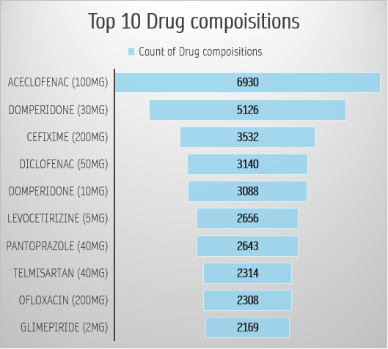
MNC owned specialty drugs dominate high price list. These follow low-volume, high margin pricing strategy.
Top 3 molecules = 46% of Top 10 composition counts, Commonly prescribed for pain, inflammation, GI disorders, and bacterial infections

Slide 5

Growth strategy/recommendations
Prioritize
Introduce
mid-range pricing in premium segments
Target
niche drugs (e.g., asthma/COPD) for seasonal promotions
high-demand categories for expansion (N05B, N02BE)

Slide 6

Thank you
Ajay Thakran | ajaythakran.analyst@gmail.com

